Slide 1

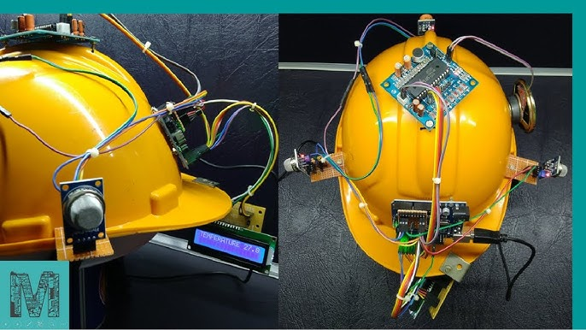
IoT Based Coal Mine Safety Monitoring and Alerting System
Presented by-
Navya Sharma (211001)
Aneesh Tiku (211010)

Slide 2
Contents
Introduction to Coal Mine
Current Safety Challenges
Flow Chart
Block Diagram
Material Required
Workflow
Some Picture
Advantage
References
Conclusion

Slide 3
Introduction to Coal Mining
The mines are the world's most dangerous mining operation, with thousands of workers dying each year as a result of massive explosions. The course of Underground digging activity for human workers could be a very risky circumstance where the dangers increment with the ascent in separation from the underground. Coal is an important asset to every country since it has a few applications. It is used for nuclear energy, concrete, and creation and as a fuel for different applications. Safe production level of coal mine is still low, disasters in coal mine occur frequently, which lead to great loss of possession and life. The disasters happening in coal mine are due to the complexity of mine environment and the variety of work carried out in coal mine, so it is very necessary to monitor the working environment of coal mine.

Slide 4
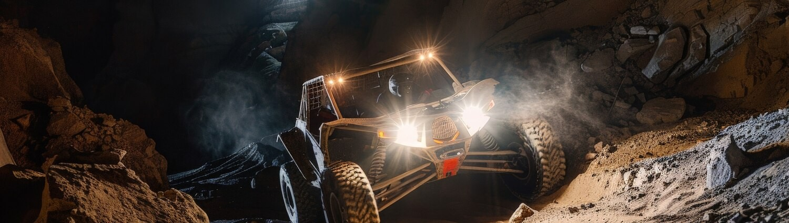
Current Safety Challenges
Coal mining poses several safety challenges, including gas emissions, equipment failures, and geological hazards. Understanding these risks is crucial for developing an effective monitoring system that can provide real-time data and alerts to prevent accidents.

Slide 5
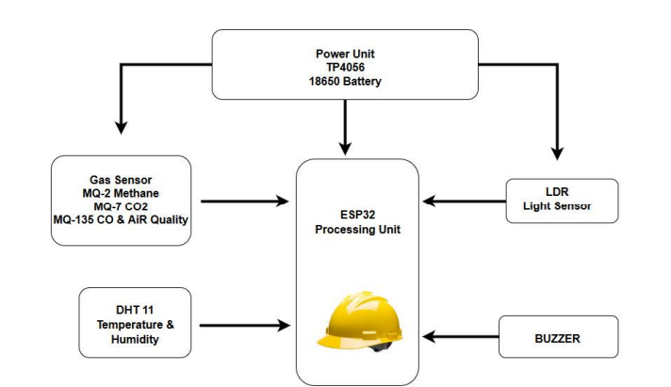
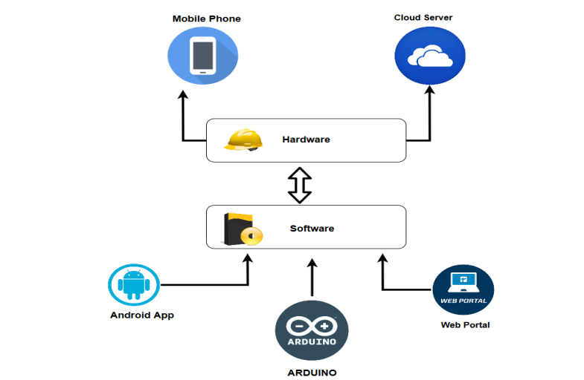
Flow Chart

Slide 6
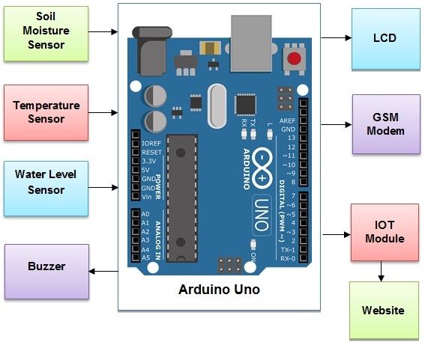
Block Diagram
MQ Gas Sensor
MQ Gas
Sensor
I2C LCD

Slide 7
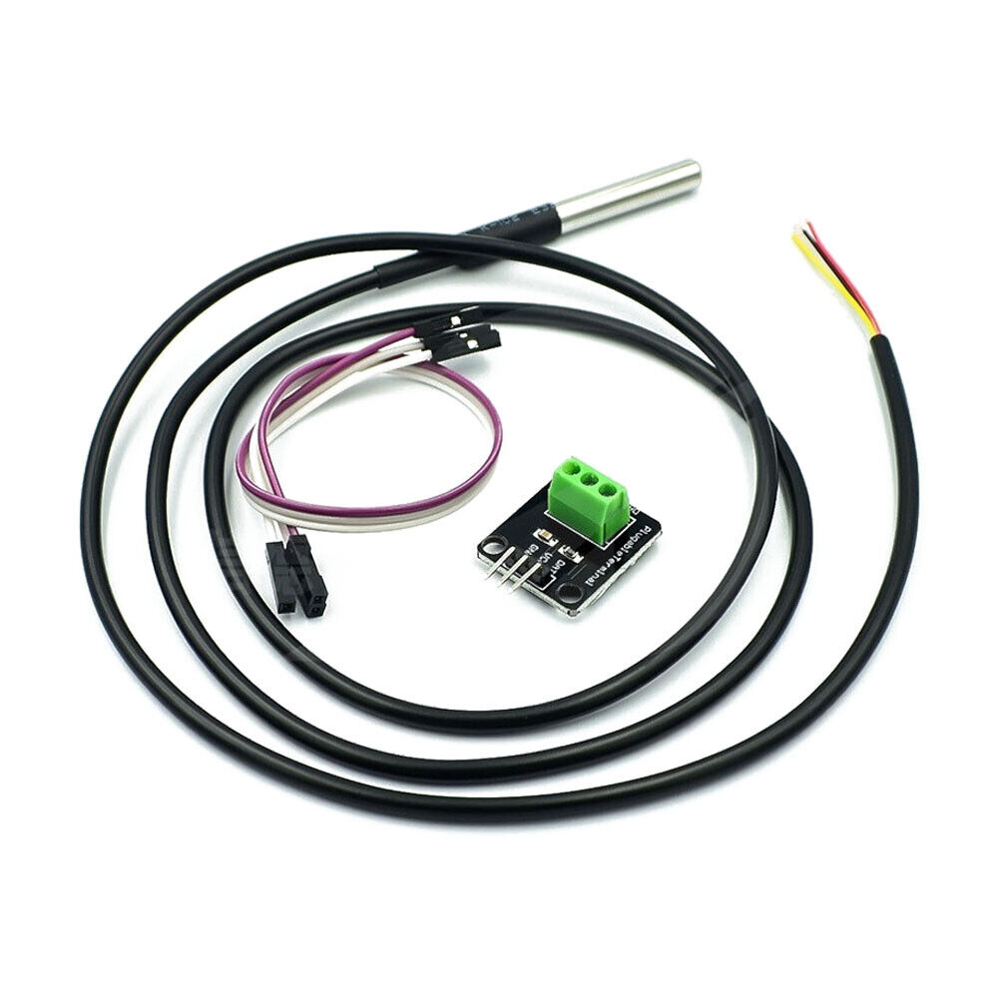
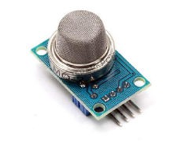
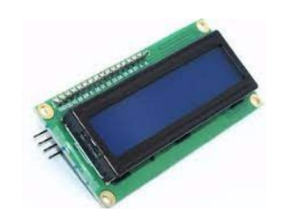
Material Required
1. Temperature Sensor:
To monitor the environmental conditions inside the mine.
2. MQ Gas Sensor:
For detecting harmful gases like methane (CH₄) and carbon monoxide (CO).
3.I2C LCD:
The character LCD is ideal for displaying text and numbers and special characters.

Slide 8
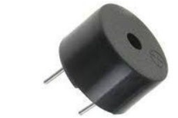
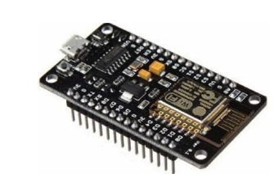
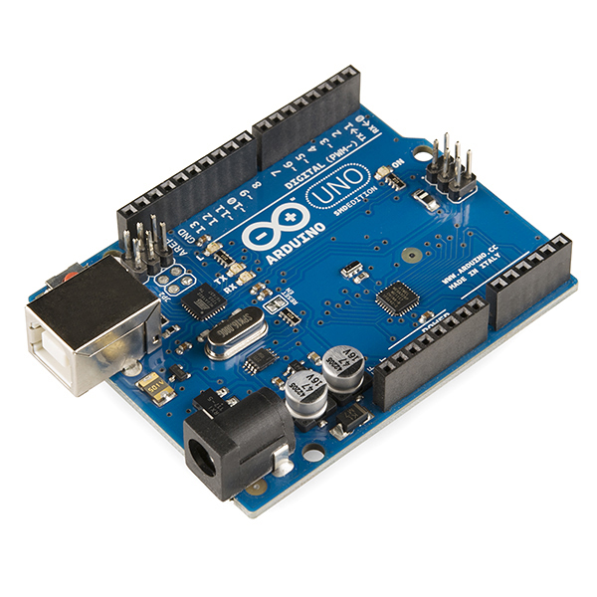
4. Piezoelectric Buzzer:
An audio signaling device like a beeper or buzzer may be electromechanical or piezoelectric or mechanical type.
5. WiFi Module:
It is a self-contained SOC with integrated TCP/IP protocol stack that can give any microcontroller access to your WiFi network.
6.Arduino:
An Arduino, Raspberry Pi, or similar microcontroller to interface with the sensors and process data.

Slide 9
Workflow
Data Collection:
Sensors continuously monitor parameters.
Data Processing:
Microcontroller checks if readings exceed safety thresholds.
Data Transmission:
Relevant data is sent to the cloud server.
Alert Generation:
If thresholds are exceeded, the system triggers alerts and notifications.
Data Visualization:
Users access real-time data through the mobile/web application

Slide 10
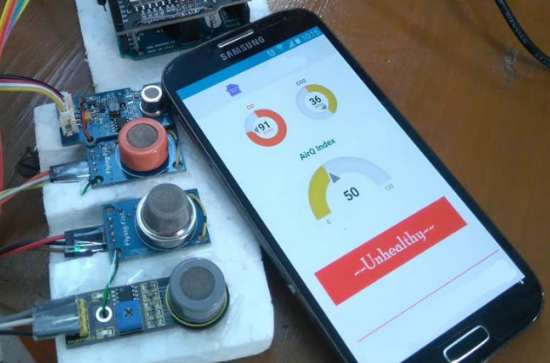
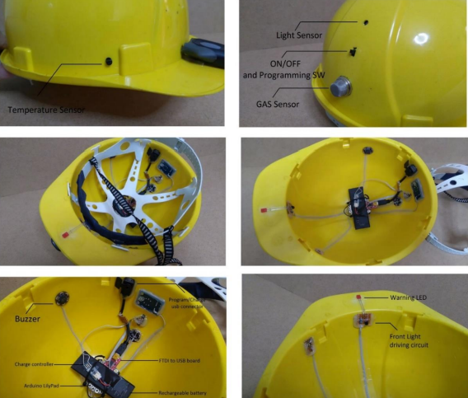
Some Pictures

Slide 11
Advantages
Enhanced Safety
Real-Time Monitoring: Continuous tracking reduces accident risk.
Early Alerts: Instant notifications for timely evacuations.
Data-Driven Decisions
Trend Analysis: Comprehensive data improves safety protocols.
Predictive Insights: Historical data aids risk assessment.
Improved Emergency Response
Rapid Notifications: Quick alerts for workers and rescue teams.
Centralized Access: Informed decisions during emergencies.
Cost-Effectiveness
Reduced Downtime: Prevents accidents, minimizing costs.
Lower Insurance: Enhanced safety can reduce premiums.
Scalability
Modular Design: Easily expandable with more sensors.
Remote Monitoring: Oversight of multiple sites from one location.

Slide 12
References
[1]. Tanmoy Maity and Partha Sarathi, “A wireless surveillance and safety system for mine workers based onZigbee”, 1st Int’l Conf. on Recent Advances in Information Technology RAIT-2012
[2]. Yogendra S Dohare and Tanmoy Maity, “surveillance and safety system for underground coal mines based onLow Power WSN”, IEEE, pp.116-119, 2014.
[3]. Pranjal Hazarika, “implementation of safety helmet for coal mine workers”, 1st IEEE
International Conference on Power Electronics Intelligent Control and Energy Systems, pp. 1-3, 2016.
[4]. Valdo Henriques and Reza Malekian, “ Mine safety system using wireless sensor network”, IEEE,
pp. 1-12, 2016.
[5]. Y.P. Zhang, G. X. Zheng, J. H. Sheng, “Radio Propagation at 900 MHz in Underground Coal Mines”, IEEE transactions on antennas and propagation, vol.49(5), pp. 752-62, 2001.
[6]. E. Stanek, “Mine Electrotechnology Research: The Past 17 Years”, IEEE transactions on industry
applications, vol. 24(5), pp 818-1988
https://www.mukpublications.com/resources/25.%20Amjad%20Chohan%20Submission_pagenumber.pdf

Slide 13
Conclusion
In conclusion, an IoT-based monitoring and alerting system is essential for enhancing safety in coal mining. By addressing current challenges and implementing innovative solutions, we can ensure a safer working environment for miners while optimizing operational efﬁciency.

Slide 14
Thank You

